Slide 1



Slide 2
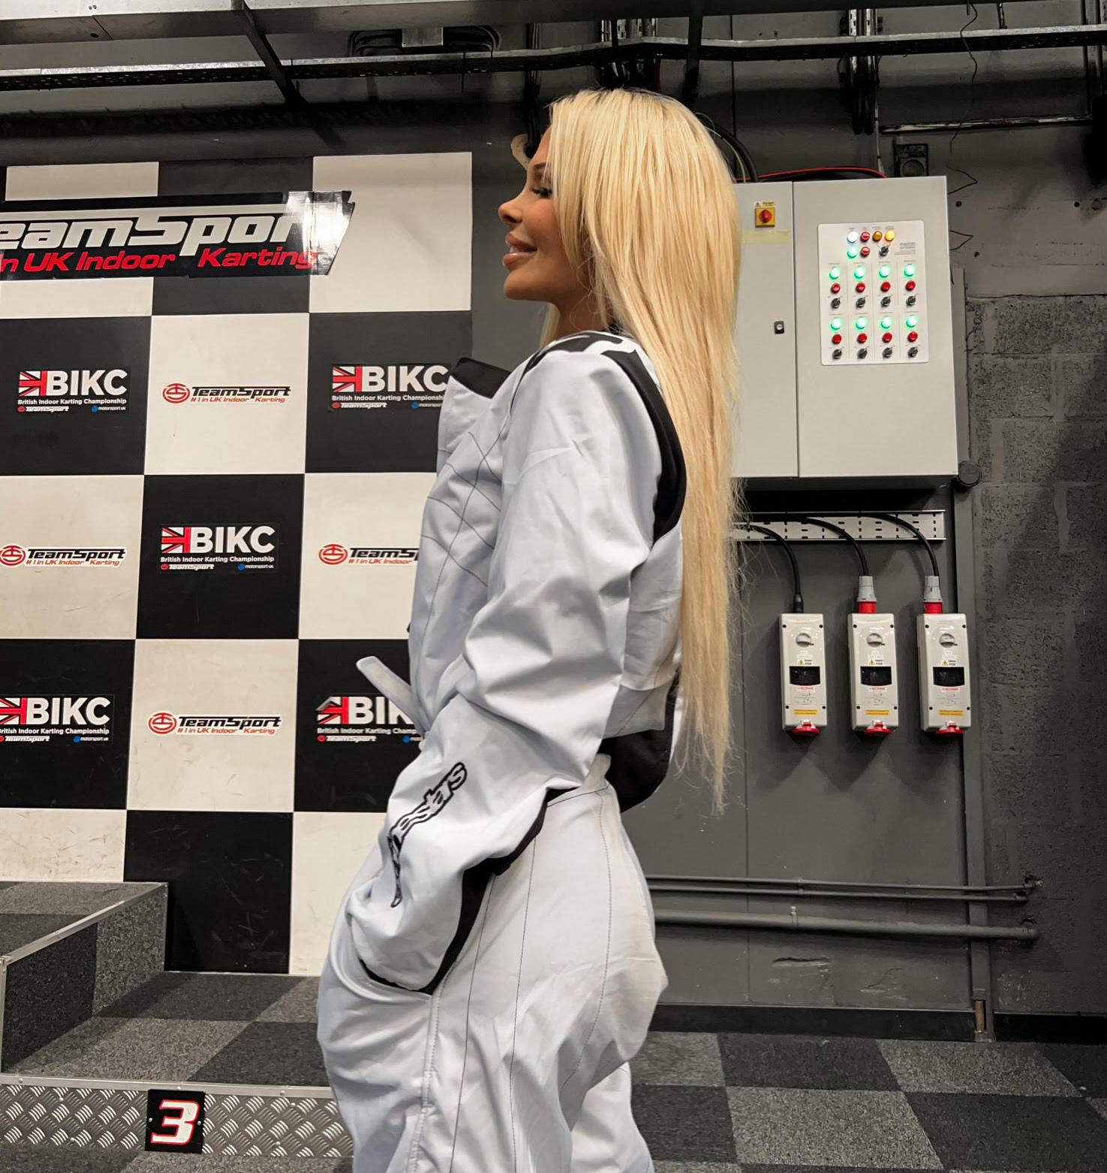
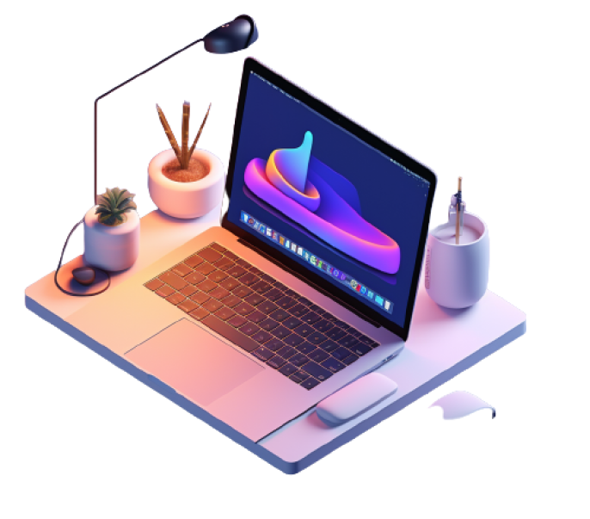

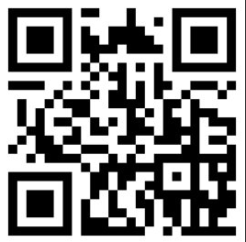
About me 🙋‍♀️
👉 Based in London, UK (for now)
👉 Senior Manager @ Big 4
👉 Frontend developer & UI/UX designer
👉 Microsoft MVP,
👉 Racing girl
👉 Gamer, drummer & nerd

Slide 3
Agenda for today 📅
1.00pm-2.00pm Intro to UI/UX
2.00pm-2.20pm Interactive UI/UX exercise
2.20pm-2.35pm Figma – crash course!
2.35pm-3.05pm Accessibility
3.05pm-3.20pm Coffee break
3.20pm-4.00pm Intro to HTML & CSS
4.00pm-4.20pm Interactive HTML & CSS exercise
4.20pm-4.55pm Intro to SVG’s and CSS animations
4.55pm-5.15pm Interactive SVG exercise
5.15pm-5.45pm Lunch break!
5.45pm-8.00pm Hands on app makeover!

Slide 4
UI Design

Slide 5
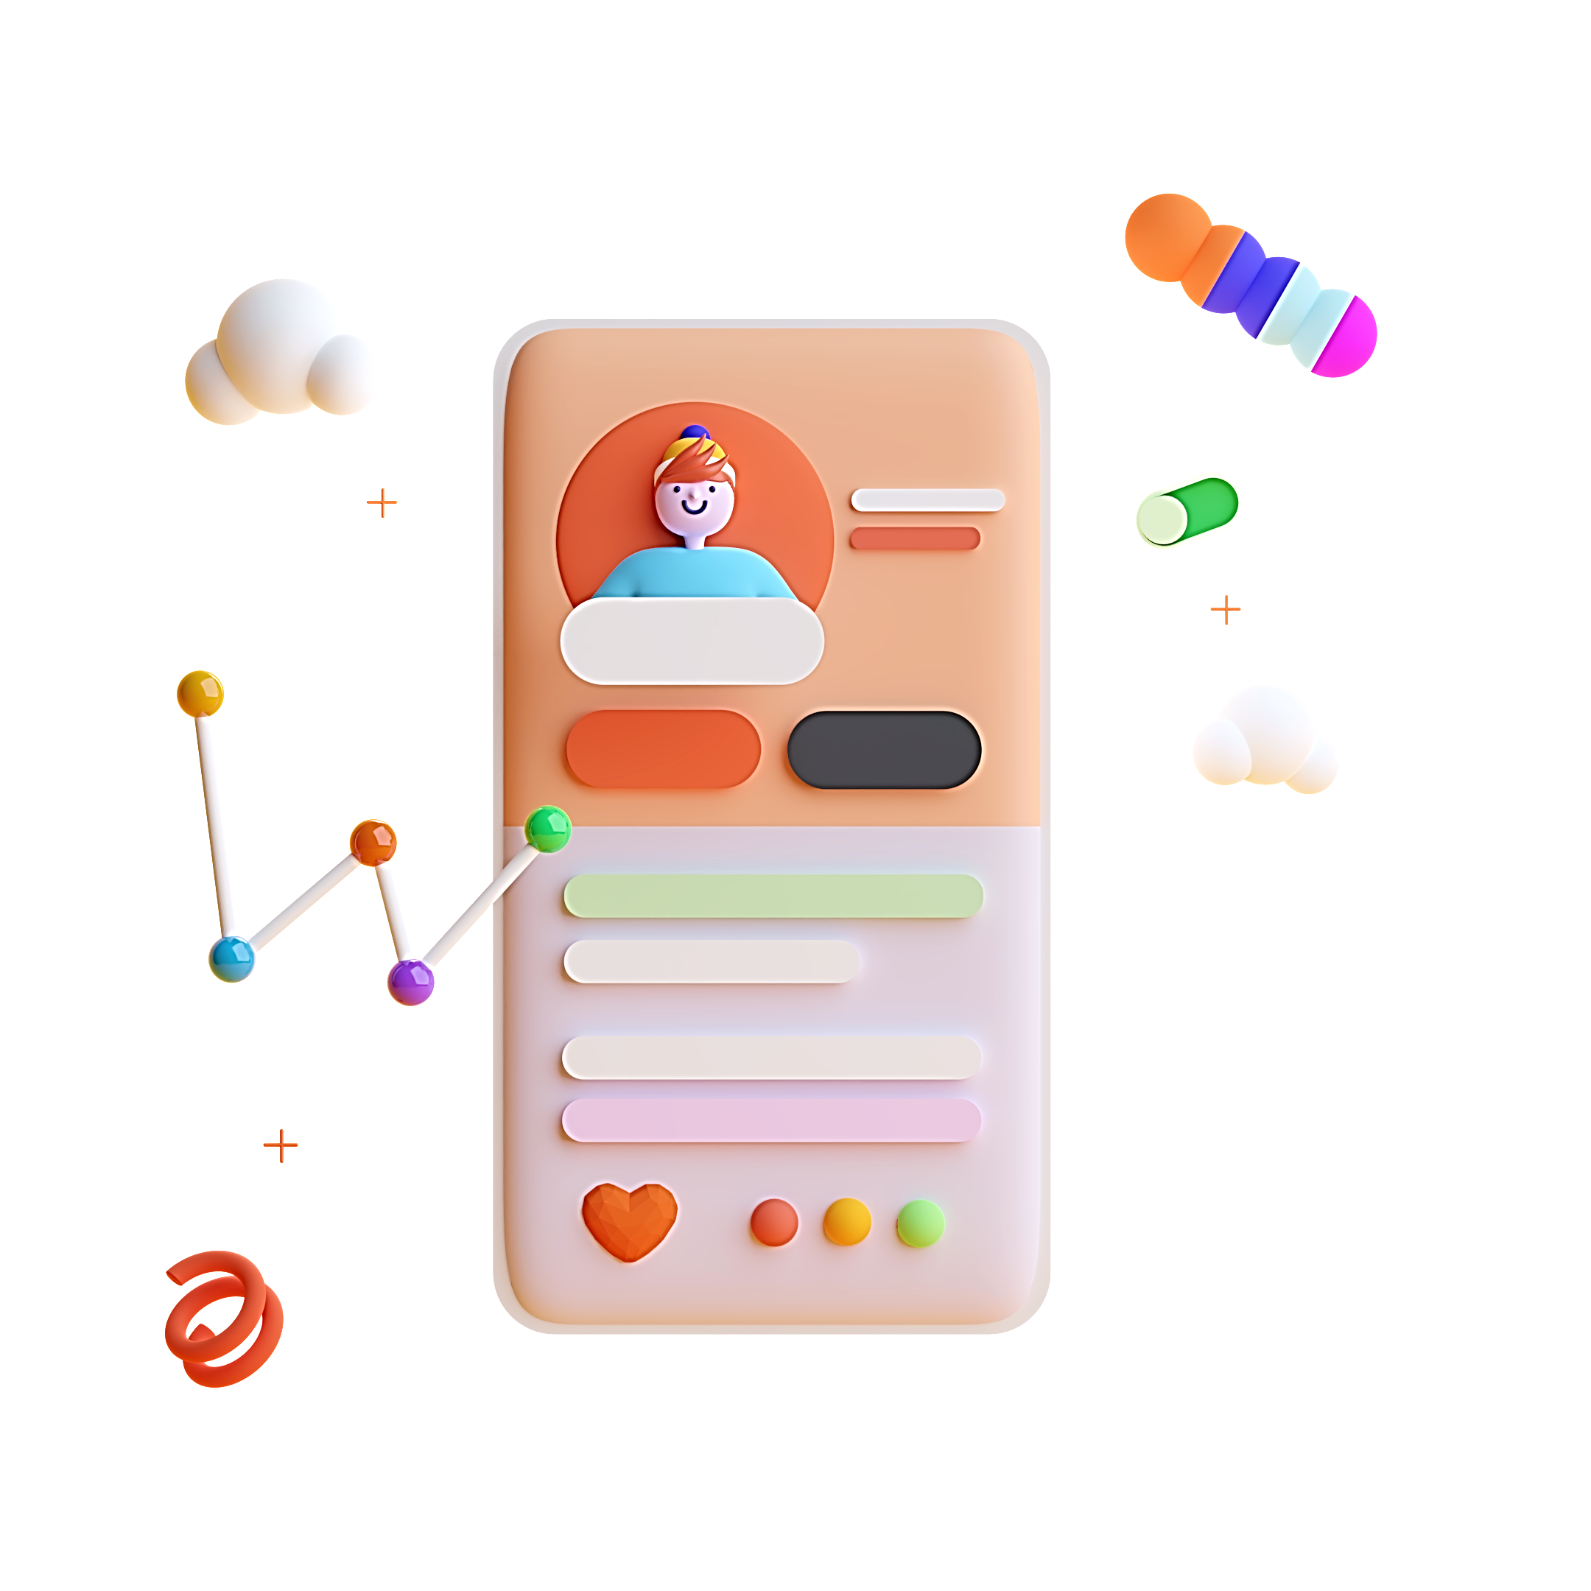
What is UI design?
designing visual interfaces for machines and software that are memorable and meaningful

Slide 6
‘Moving rectangles for a living’

Slide 7

Design principles

Slide 8
Design principles
C
R
A
P

Slide 9
Design principles
C
ontrast
R
epetition
A
lignment
P
roximity

Slide 10
Let’s see how these apply!

Slide 11
Typography

Slide 12
Typography
Simple = legible
Hello
Hello
Hello
Hello
Hello
Hello
Hello
Hello
Hello
Hello
👎
👍

Slide 13
Typography
Cursive and decorative fonts are a no go.
Welcome to my application
Welcome to my application.
👎
👍

Slide 14
Typography
Emphasize text to create contrast.
Welcome, Kristine.
Welcome, Kristine.
👎
👍

Slide 15
Typography
Do not use underlined text for plain text.
Welcome, Kristine.
Welcome, Kristine.
👎
👍

Slide 16
Typography
Left aligned text is more legible.
Pavlova is a meringue-based dessert. Originating in either Australia or New Zealand in the early 20th century, it was named after the Russian ballerina Anna Pavlova. Taking the form of a cake-like circular block of baked meringue, pavlova has a crisp crust and soft, light inside.
Pavlova is a meringue-based dessert. Originating in either Australia or New Zealand in the early 20th century, it was named after the Russian ballerina Anna Pavlova. Taking the form of a cake-like circular block of baked meringue, pavlova has a crisp crust and soft, light inside.
👎
👍

Slide 17
Icons

Slide 18
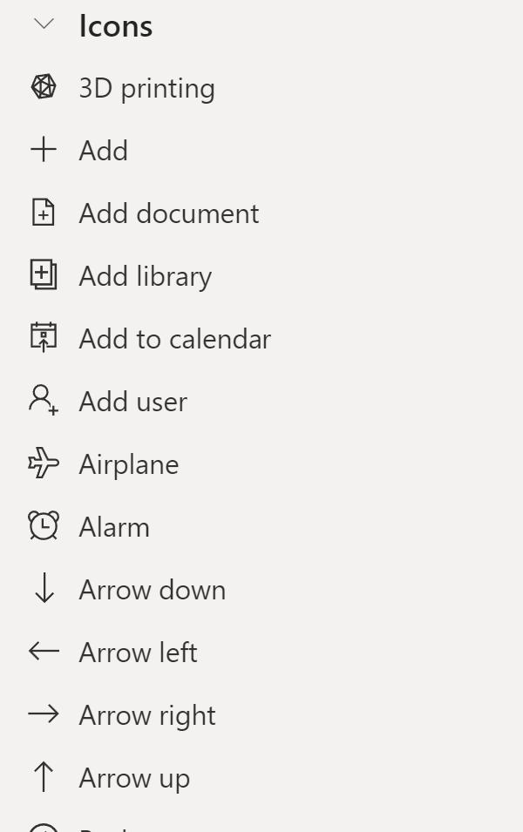
Icons

Slide 19
Icons

Slide 20

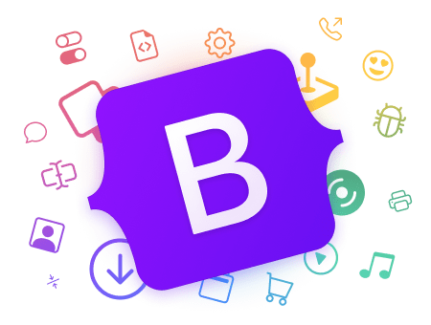
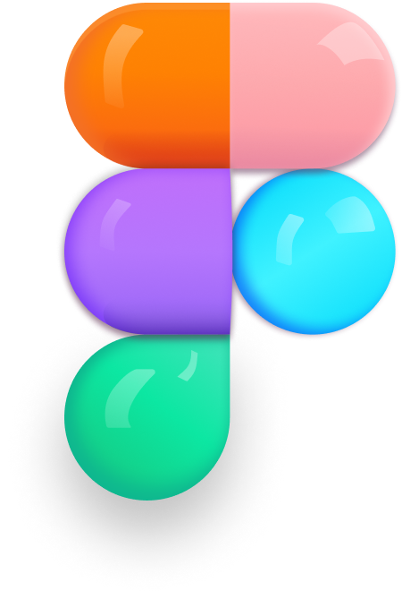
Icons

Slide 21
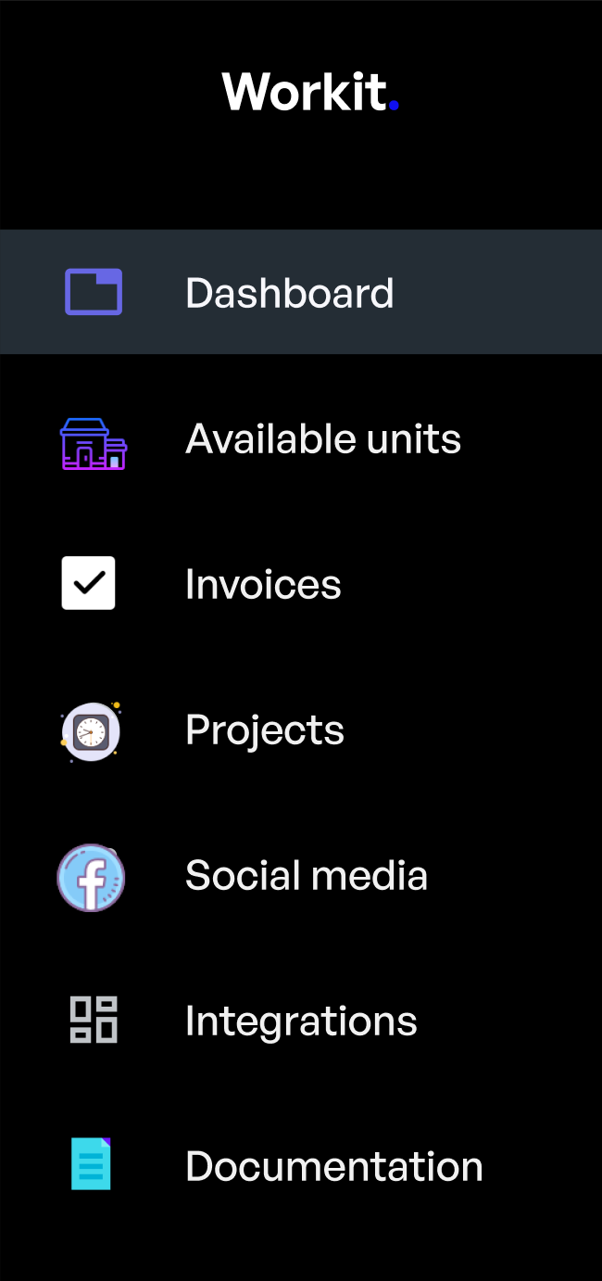
Icons
Only use icons from one icon set to keep you design consistent.

Slide 22




Icons
Select one style and use it consistently.

Slide 23
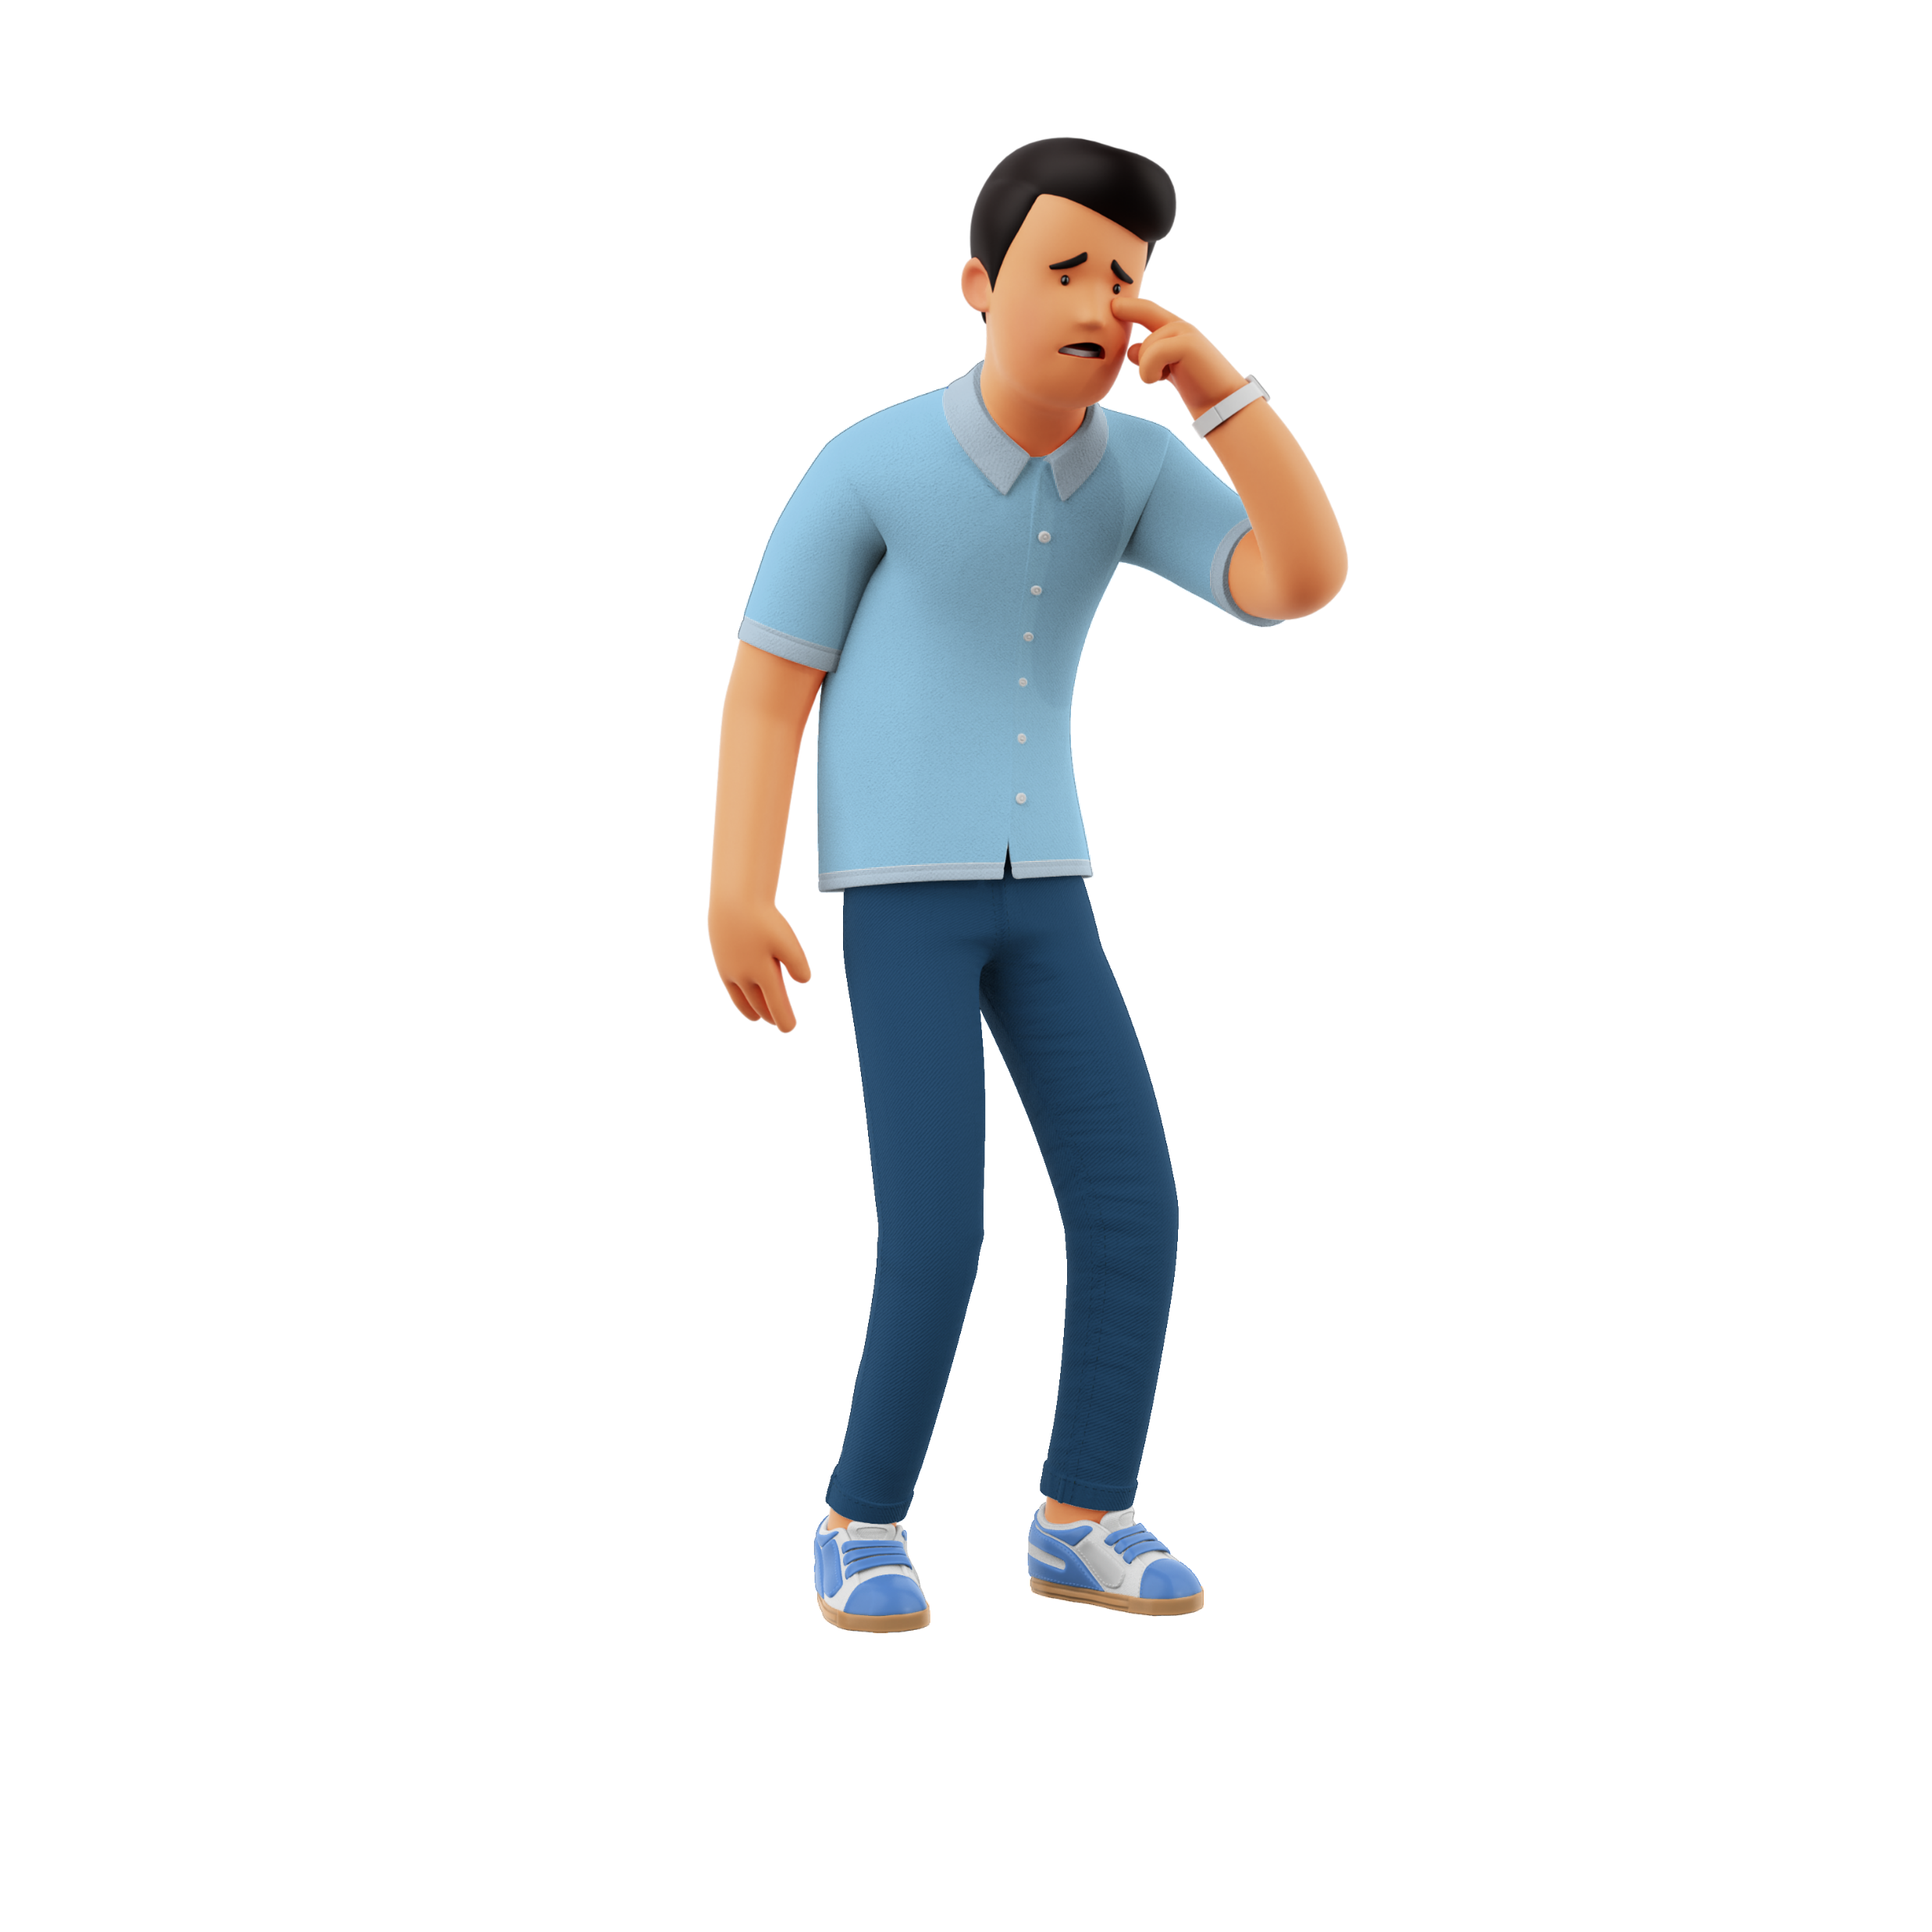
‘I’m not very creative…’

Slide 24
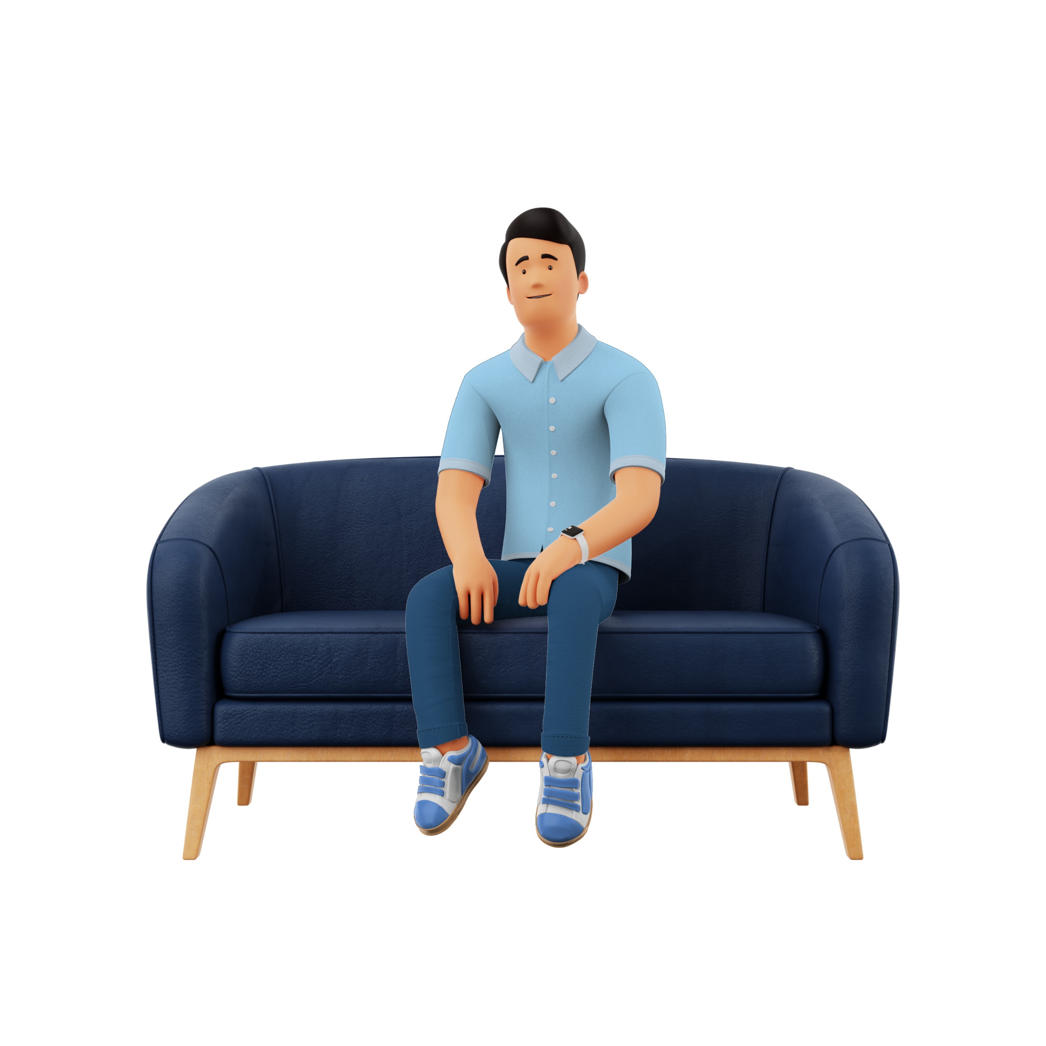
I’ve got you 😎

Slide 25
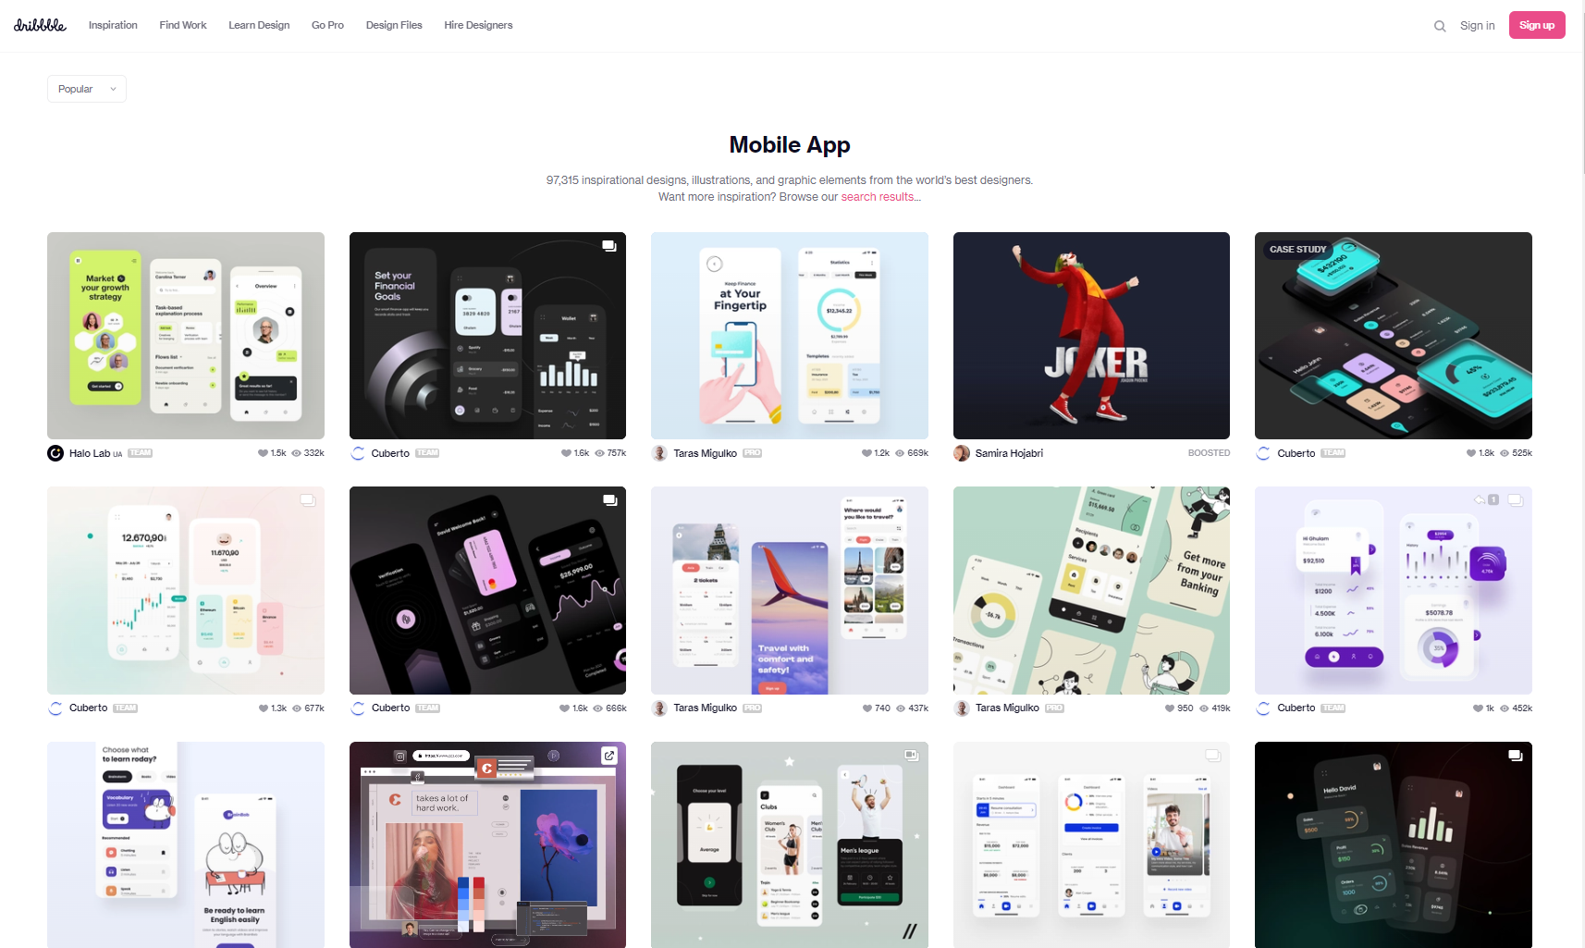
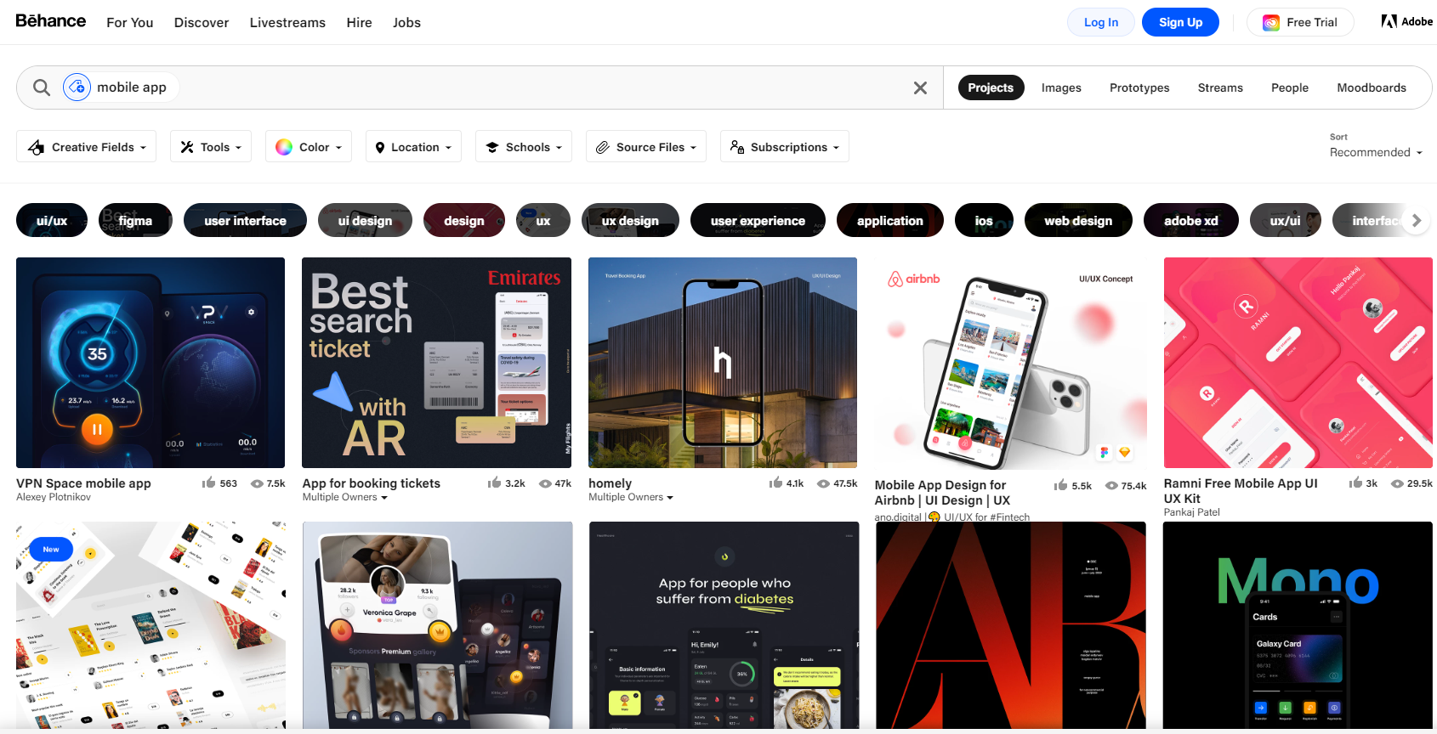
Inspiration everywhere ✨
Dribbble
Behance

Slide 26
UX Design

Slide 27
UX Design
to plan how something looks and works to make the activity of using it easy and enjoyable

Slide 28

What is good UX design?
Think of the last app you downloaded on your mobile…

Slide 29
Does UX even apply to low code?
Kind of...
Let’s explore

Slide 30
Traditional UX process
User research
Analysis
Validation
implementation

Slide 31
‘Hey Kristine, can you build
this quick Canvas App?’
👋
👋
‘Sure, let me just do some user research, write some case studies, do some wirefames, iterate them with you and then I’ll start building!’
👋
👋
👋

Slide 32
6 principles to keep in mind
Useful
Usable
Desirable
Memorable
Accessible
Credible

Slide 33
Design tools

Slide 34
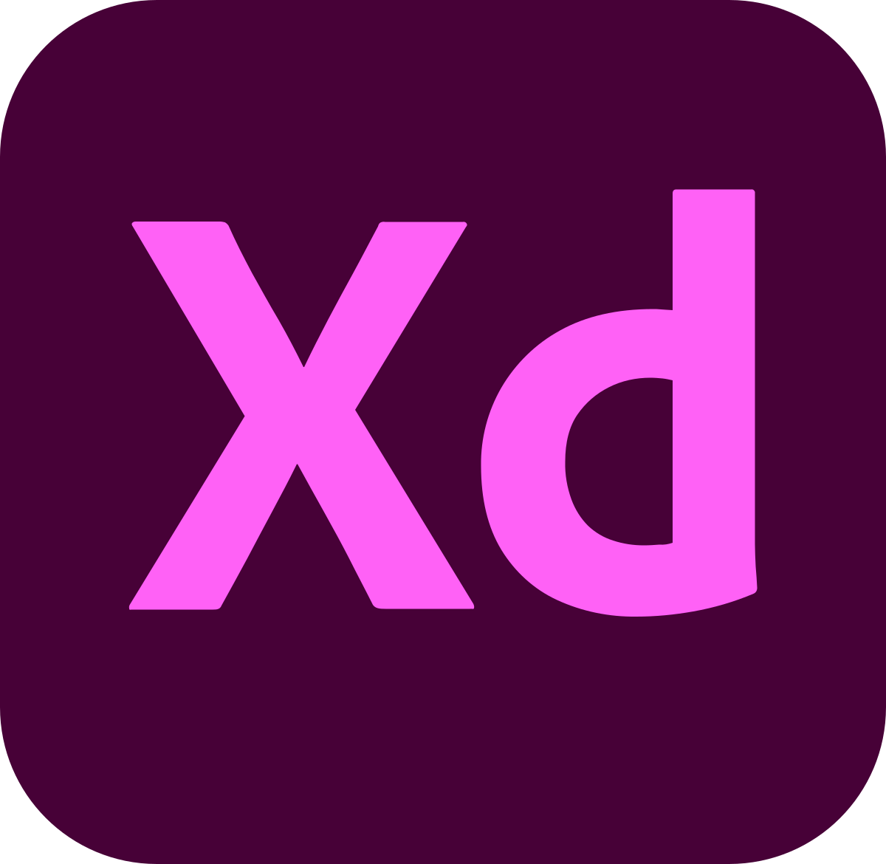

Design tools

Slide 35
Figma

Slide 36
Responsive design

Slide 37
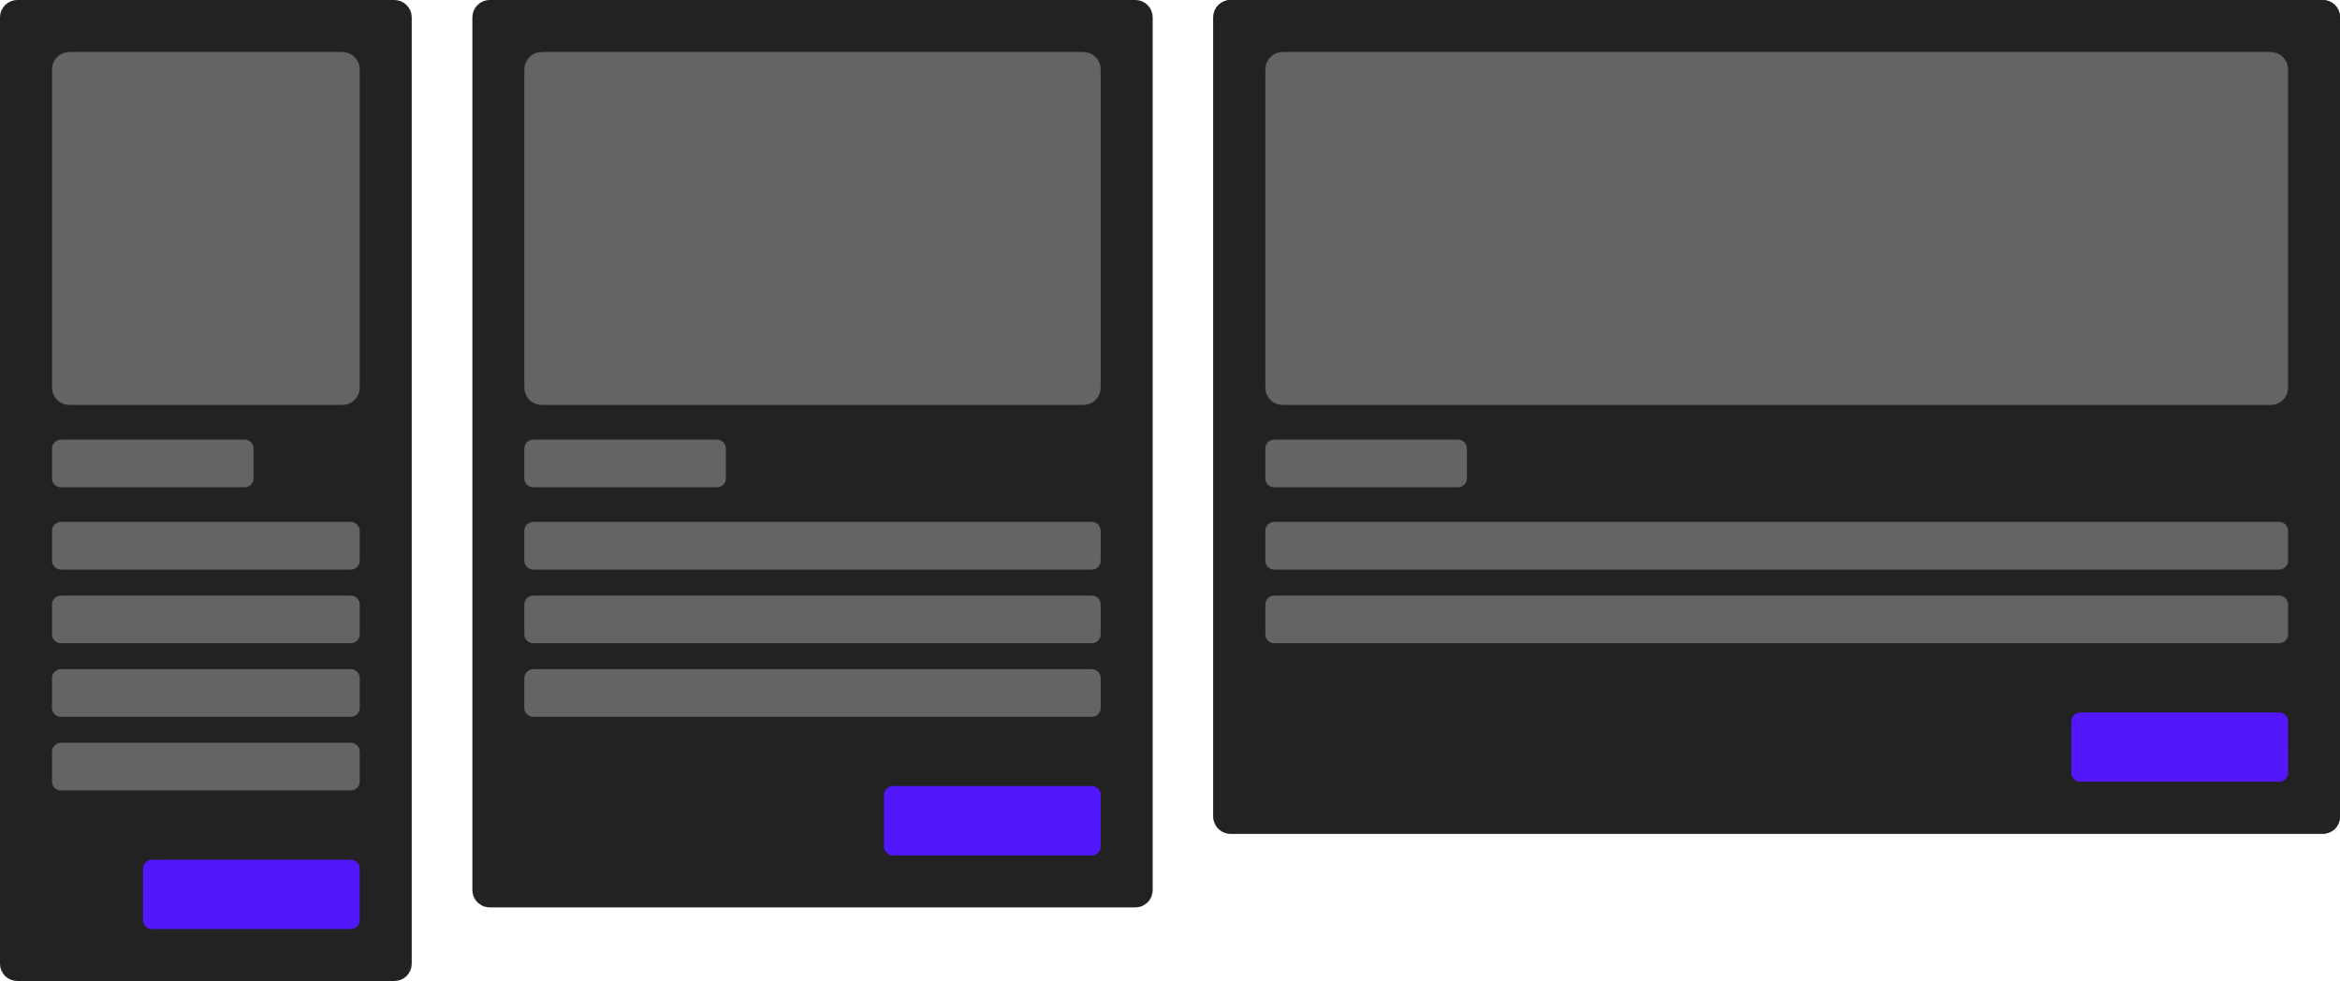
Responsive design
a web design approach to make web pages render well on all screen sizes and resolutions while ensuring good usability. It is the way to design for a multi-device web.

Slide 38
Should my applications be responsive?
Well…. It DEPENDS.

Slide 39
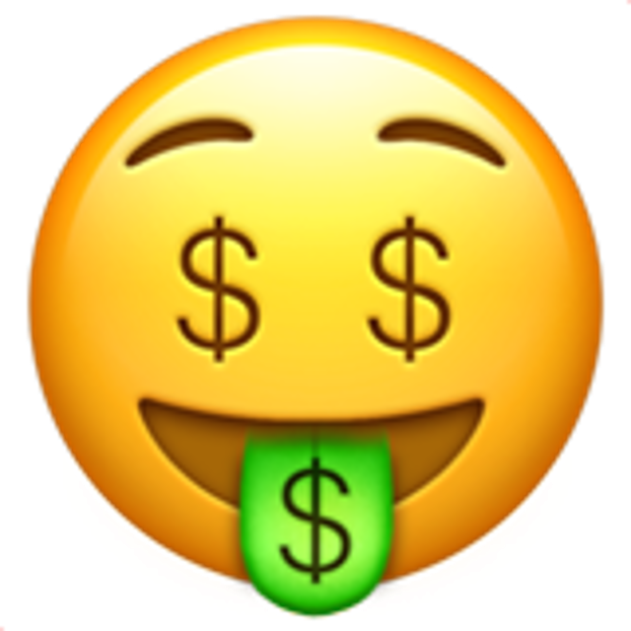

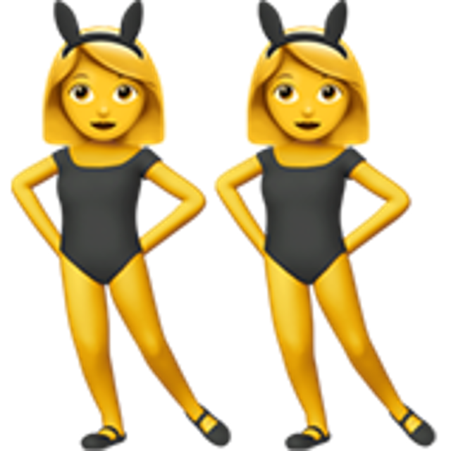

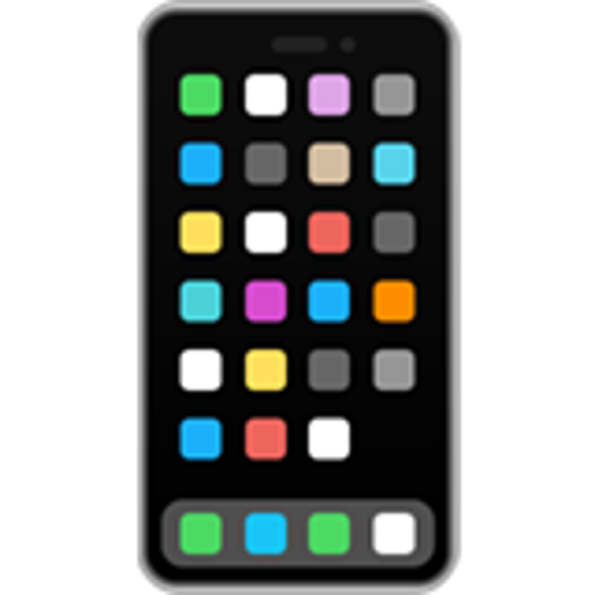
Well…. It DEPENDS.
Budget
Time
Users
Devices
Security

Slide 40

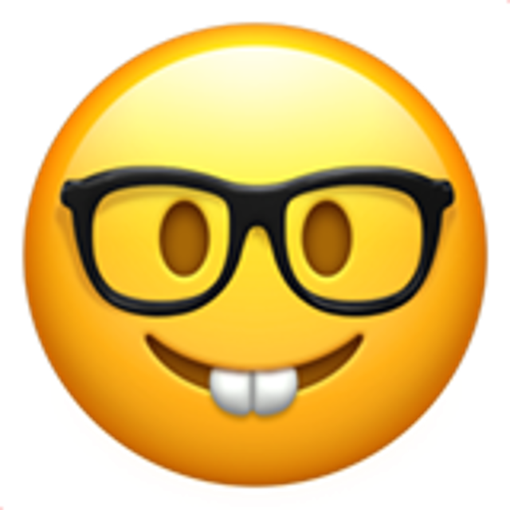

3 things to consider
Maintenance
Skills
Performance

Slide 41


HTML & CSS

Slide 42
Hypertext Markup Language

Slide 43
Hypertext Markup Language
standard markup language for documents designed to be displayed in a web browser

Slide 44
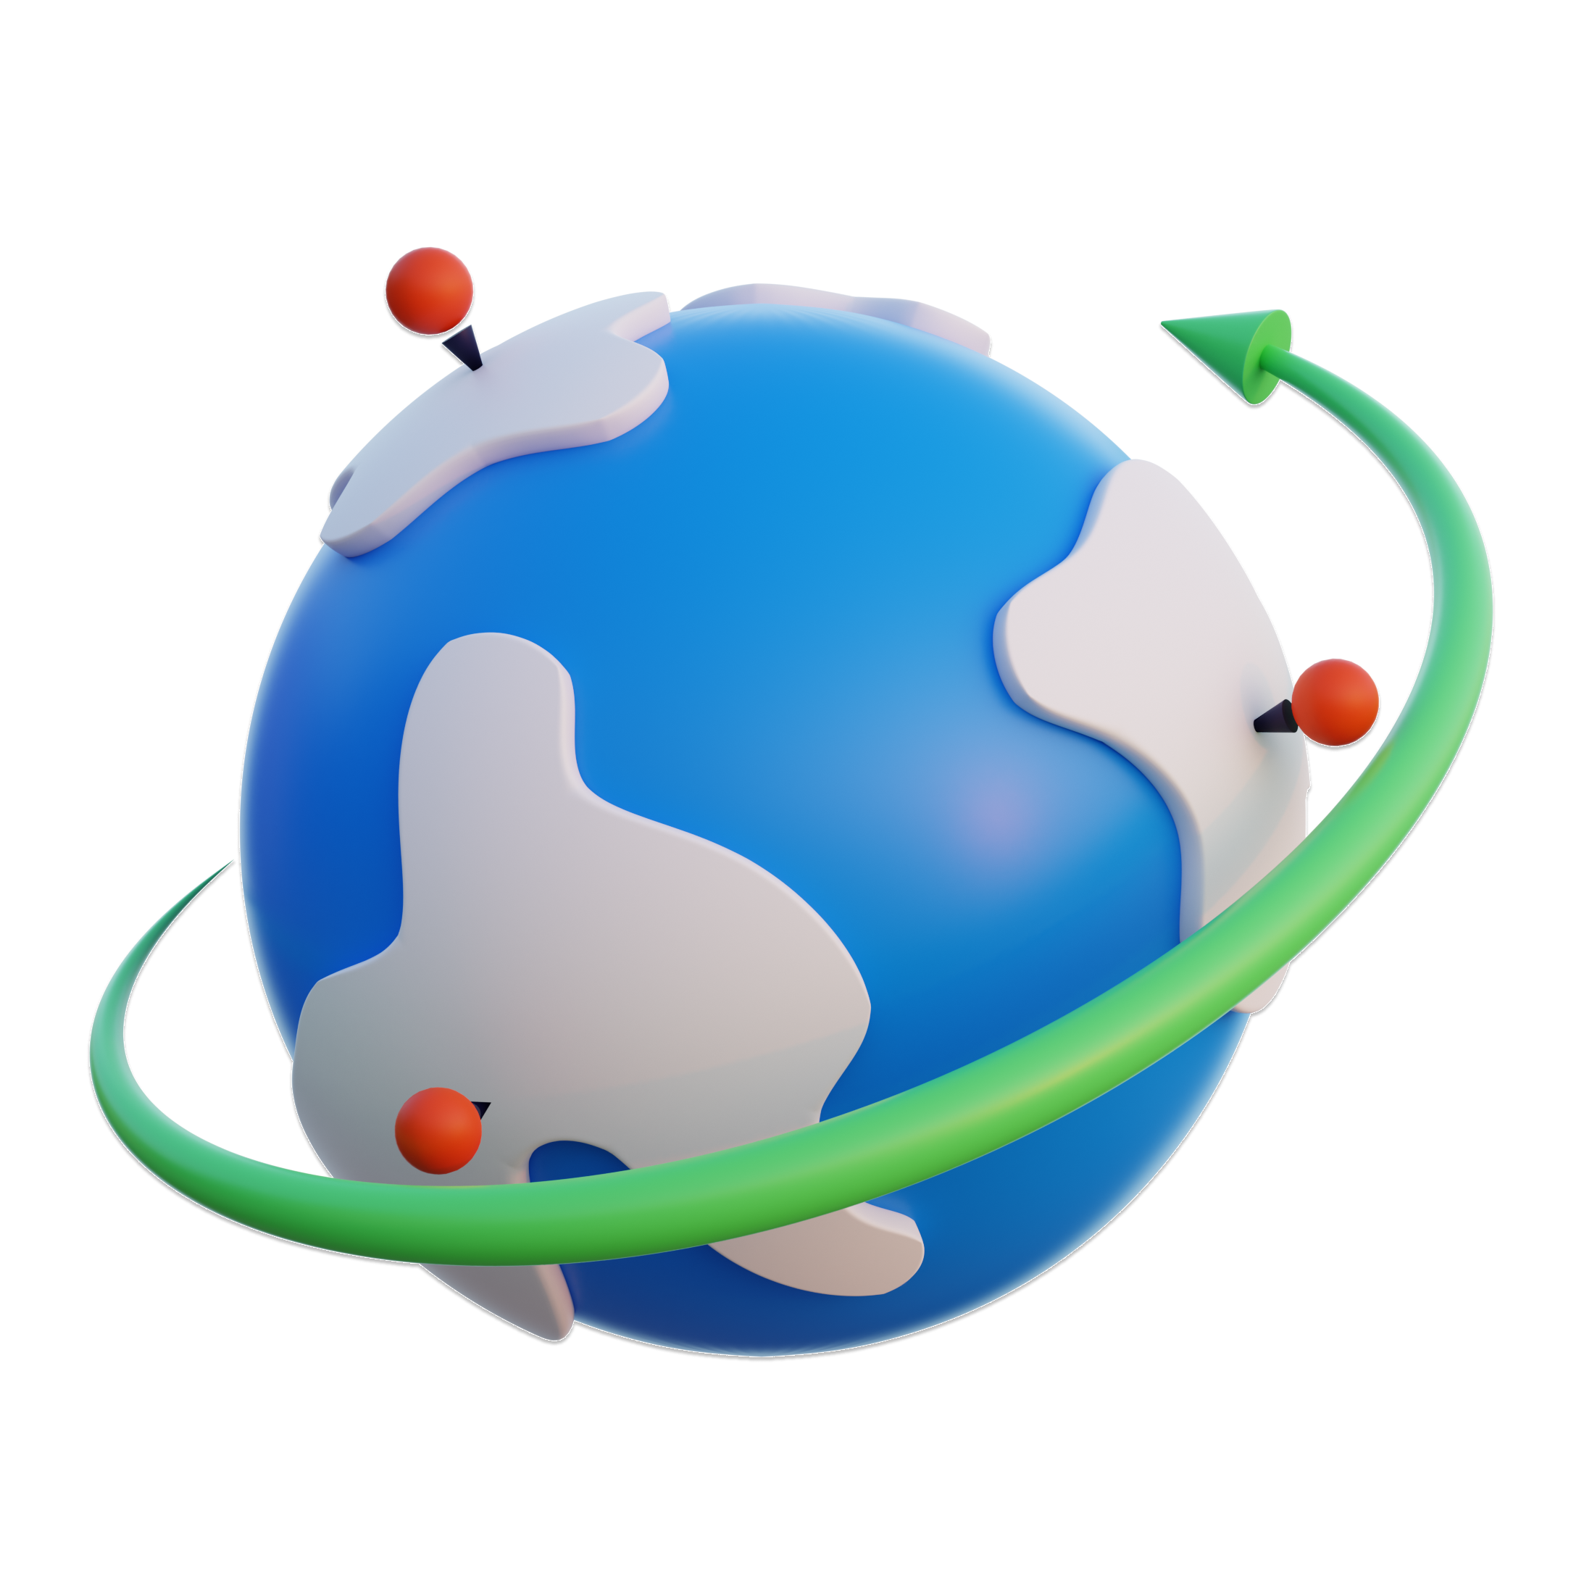

Slide 45
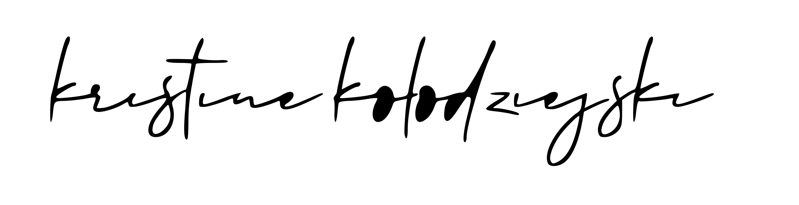
HTML
<div class=“container”> </div>

Slide 46
Hypertext Markup Language
standard markup language for documents designed to be displayed in a web browser

Slide 47
HTML
HTML element
<div class=“container”> </div>
opening tag
closing tag
Notes:
In HTML you will llikely have hundreds of those
Most elements have an opening and a closing tag

Slide 48
HTML
<img src=“url-link" alt=“alt-text"/>
self-closing HTML element
Notes:
Some elements don’t have a closing tag

Slide 49
HTML
value
element name
<div class=“container”> Hi! </div>
attribute
content
Notes:
There are just over a hundred elements. They are not relevant to us but good to know for future
Attribute can be class or id – these allow us to name elements so we can target them using CSS and JS
Content can

Slide 50
What is CSS?
Cascading Style Sheets
Notes:
This is the basic structure of CSS
Usually we will have hundreds of rulesets

Slide 51
What is CSS?
Cascading Style Sheets
style sheet language used to style HTML content
Notes:
This is the basic structure of CSS
Usually we will have hundreds of rulesets

Slide 52

CSS
.ninja {
visibility: hidden;
color: black;
}
ruleset
Notes:
This is the basic structure of CSS
Usually we will have hundreds of rulesets

Slide 53
CSS
.ninja {
visibility: hidden;
color: black;
}
selector
property
value
Notes:
Selectors are a way of selecting a html element to apply styling
The selector will vary based on the attribute – if it’s a class, we use a period (.), if it’s an I, we use a hashtag, or we can style ALL elements

Slide 54
CSS
<div class=“container”> </div>
Notes:
Inline styling

Slide 55

Demo time
Notes:
There are just over a hundred elements. They are not relevant to us but good to know for future
Attribute can be class or id – these allow us to name elements so we can target them using CSS and JS
Content can be anything

Slide 56

Introduction to SVG

Slide 57
What are SVGs?
SVG is short for Scalable Vector Grahpics, an XML-based image format for two-dimensional graphics

Slide 58
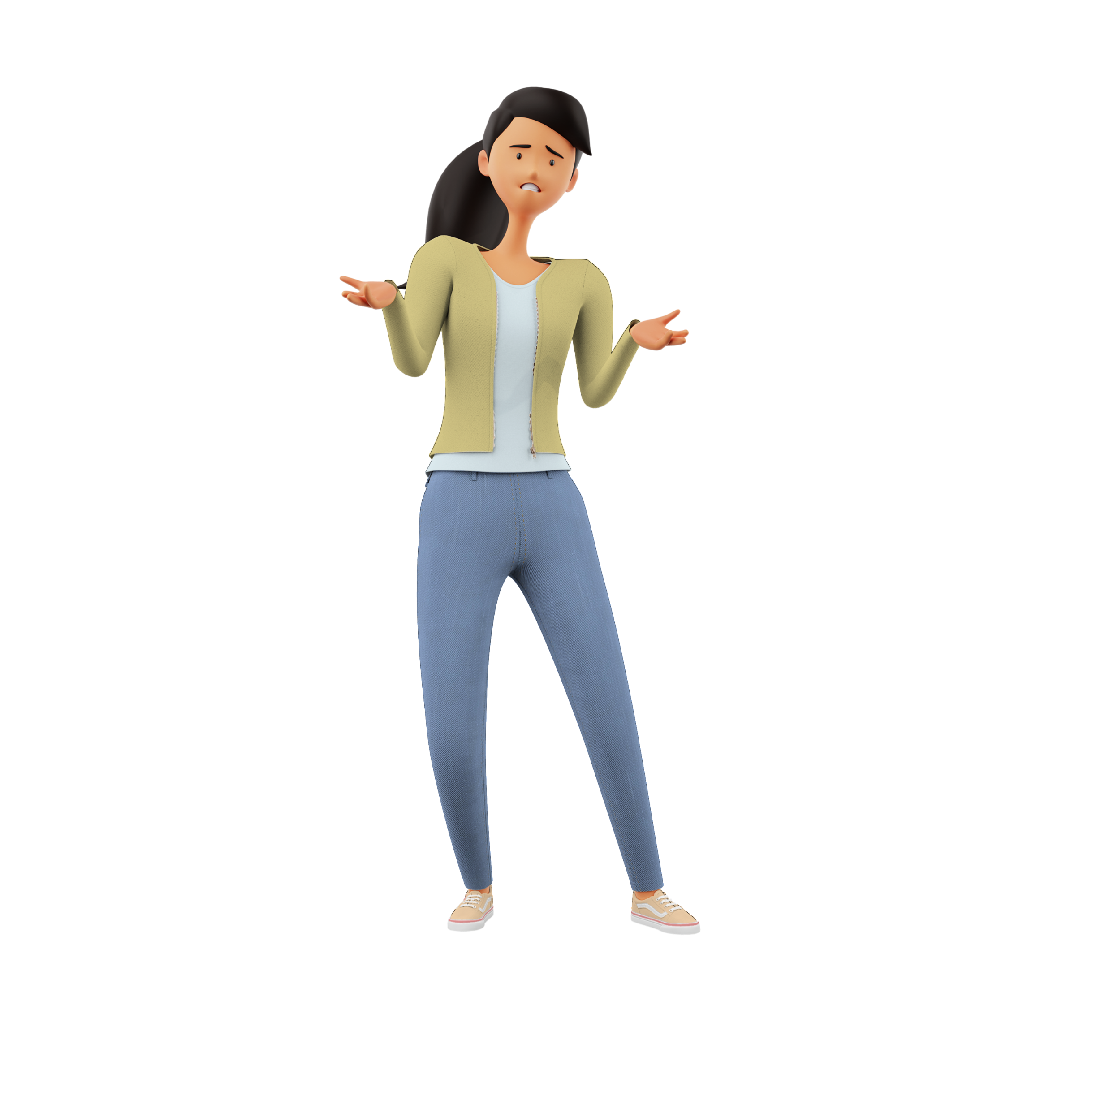
What are SVGs?
????

Slide 59


Standard image vs SVG

Slide 60
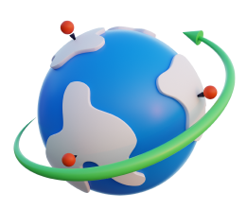
SVGs can be 3d too.. *kinda*

Slide 61
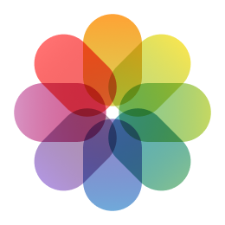
When to use what format?
(in Power Apps context)
Loading screens
Complex images
Company logos
Photography
Animations
3D & isometric imags
Extend existing icon sets

Slide 62
SVG in Power Apps
To add SVG images into Power Apps, we have to use the EncodeUrl function to translate special characters into ASCII.
“data: image/svg + xml; utf8, “& EncodeUrl (“ our SVG code ”)

Slide 63
SVG animations in Power Apps
SVG’s are at present the only way to create animations within Power Apps (excluding GIF’s and timer control)

Slide 64

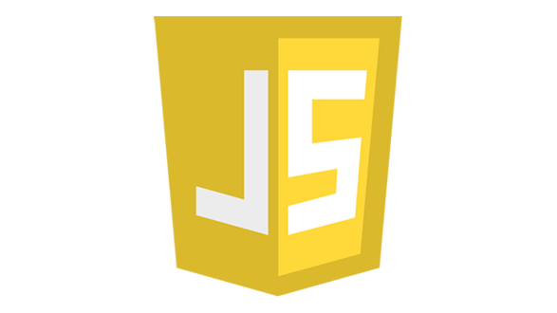
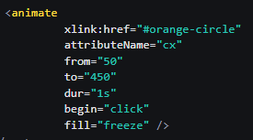
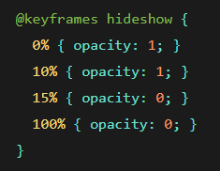
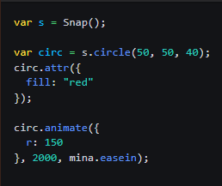
SVG animations in Power Apps
SMIL

Slide 65
SVG animations in Power Apps
SMIL

Slide 66

Accessibility

Slide 67
What is accessibility?
the practice of making your websites usable by as many people as possible

Slide 68
‘It doesn’t affect many people’
15%
73%
71%
70%
of the world population has a permanent disability
of disabled users experienced issues with apps and websites
of those users will also click away from your app/website if it’s problematic
of all websites checked for accessibility had major issues

Slide 69
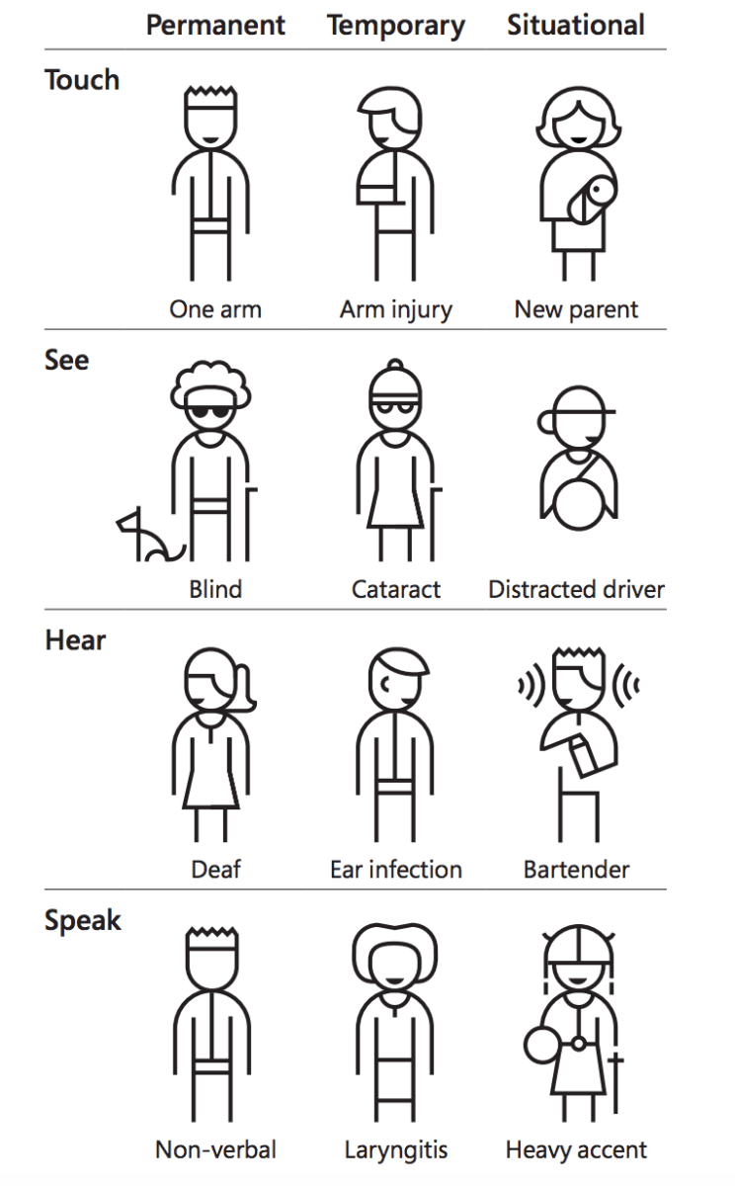
Types of accessibility
by Microsoft

Slide 70

Accessibility in the Power Platform
Color contrasts
Easy to understand
Alt text
Keyboard navigation
Logical layout
Accessibility checker
Focused borders

Slide 71
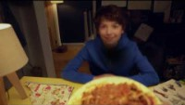
Why does it matter?

